Slide 1
Heat Pump Rebates for Electric Multi-Unit Residential Buildings
July 9, 2025

Slide 2
Land Acknowledgment
The HPSC recognizes and acknowledges with deep appreciation the unique history, languages, and cultures of the 203 First Nations across BC on whose territories we live, work, play and learn.
Learn more about the traditional Indigenous lands where you live and work at Native-Land.ca
Notes:
We would like to start with a land acknowledgment. The presenters are joining from various locations today so
the HPSC recognizes and acknowledges with deep appreciation the unique history, languages, and cultures of the 203 First Nations across BC on whose territories we live, work, play and learn.
Learn more about the traditional Indigenous lands where you live and work at Native-Land.ca

Slide 3
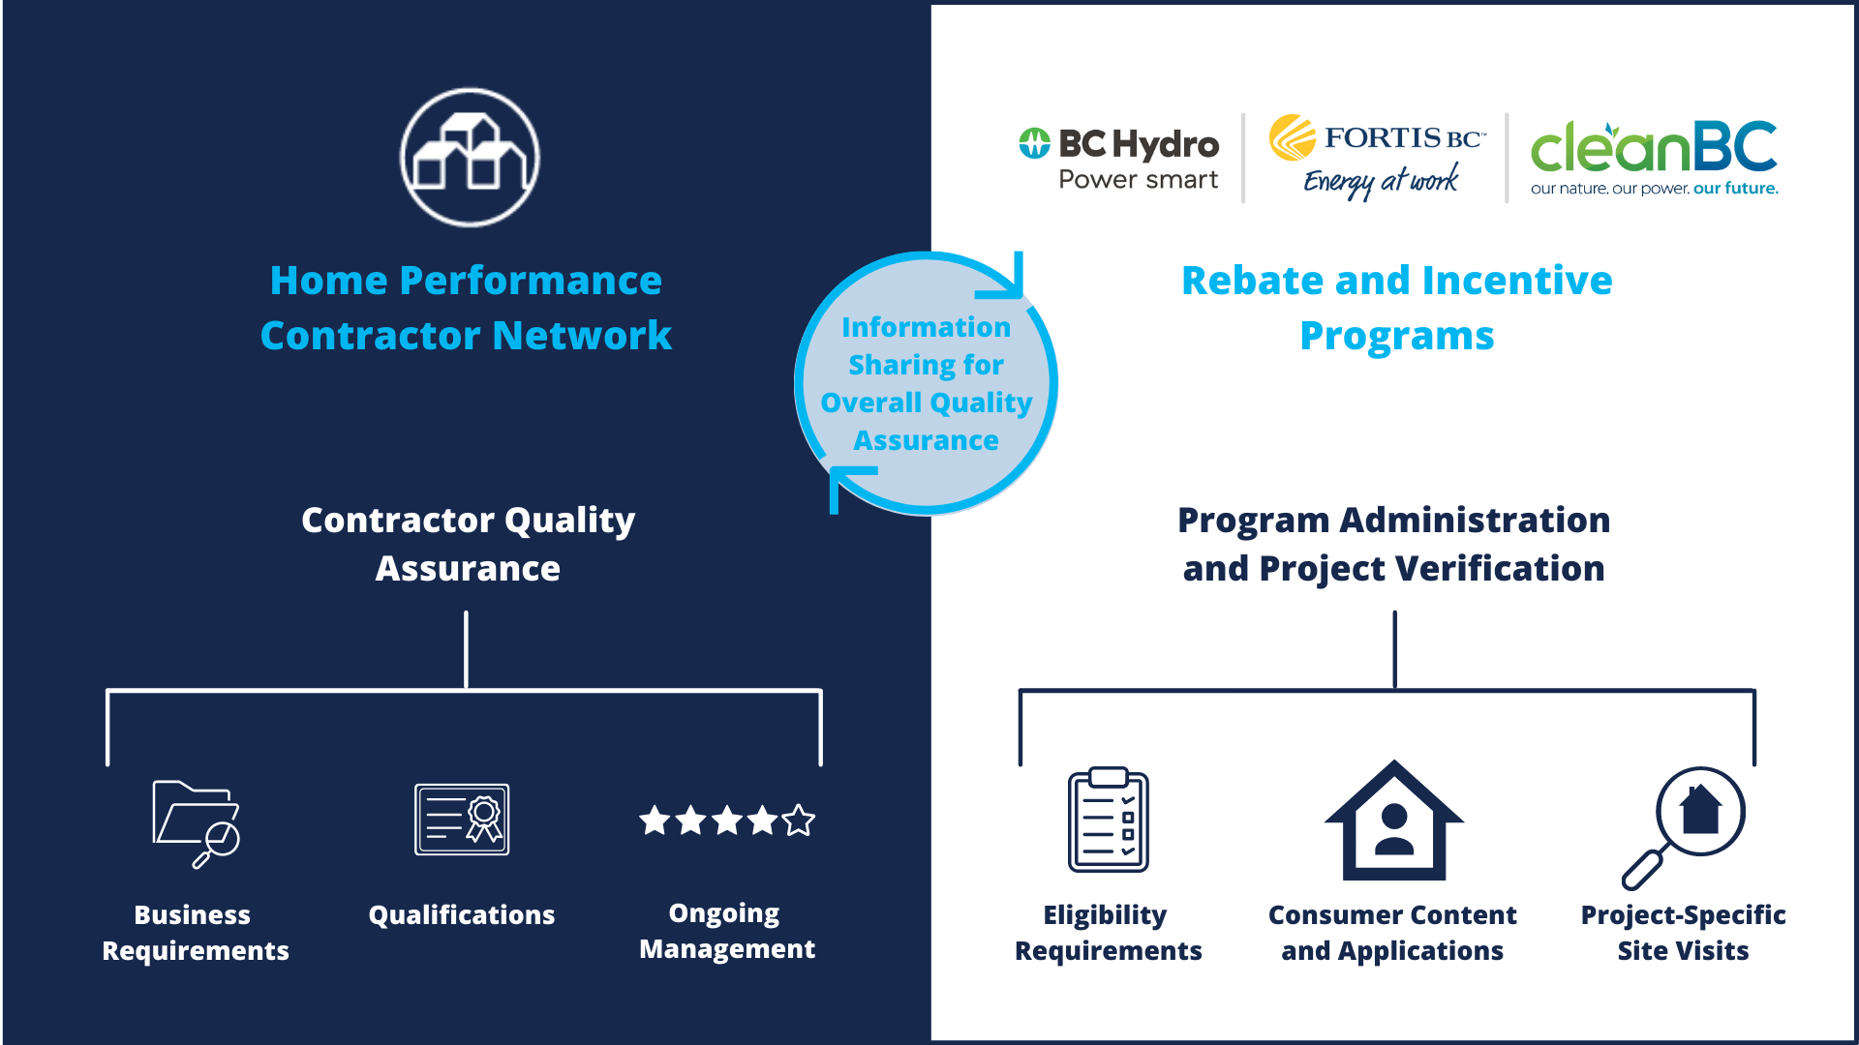

About the HPCN
CleanBC Better Homes Income Qualified Program (coming soon)
Notes:
Separate and distinct but work together

Slide 4
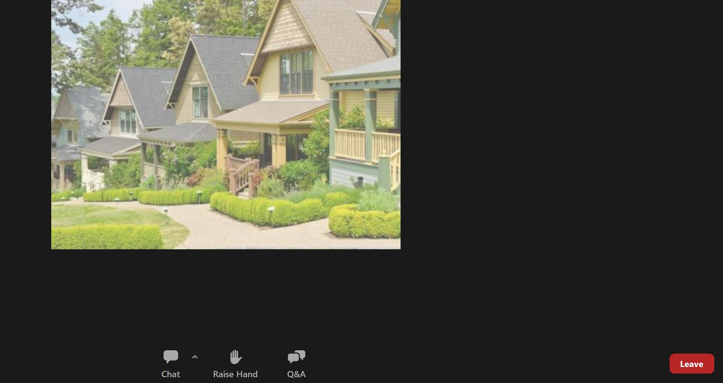
Housekeeping
The webinar will be recorded, and a link will be emailed to all registrants.
There will be a Q&A time after the presentation.
Questions
  Anytime: Type your questions or upvote other questions
  During Q&A time: Raise your hand and wait to be unmuted
Comments/discussion
  Use the chat box

Slide 5
Condo & Apartment Rebates
HPCN Contractor Training
July 9, 2025

Slide 6
Launching July 15, 2025
Rebates for heat pumps and heat pump hot water heaters in
condos and apartments

Slide 7
Agenda
Overview of BC Hydro heat pump and heat pump hot water heater rebates.
  General eligibility, product and installation requirements
  Review the application process and customer invoice requirements
Overview of CleanBC heat pump and heat pump hot water heater rebates
  General eligibility, product and installation requirements
  Review application process and customer invoice requirements
Opportunity to ask questions

Slide 8
Rebates overview – BC Hydro
Type | Rebate Amount
Ductless mini-split heat pump | $1,000
Ductless multi-split heat pump | $750 per head, to a maximum of three
Heat pump hot water heater | $1,000

Slide 9
General eligibility requirements
Review full terms and conditions for the program – bchydro.com/condorebates
The unit must have a residential account with BC Hydro or the City of New Westminster.
Home must be a year-round primary residence
Utility accounts must be in the name of the resident and/or homeowner or in the name of a strata corporation.
Non account holders must complete the utility account holder consent form
Must have approval by the strata or equity co-op board

Slide 10
General eligibility requirements
Home must be an apartment or suite in a purpose-built rental, strata condominium, or equity co-op building, older than 12 months and one of the following building types:
  Low and high-rise apartment buildings
  Stacked townhome buildings
  Multiplexes with six or more units
The following types of homes are not eligible for this offer:
  Single-family homes (detached dwelling) and secondary suites in a single-family home (detached dwelling).
  Mobile homes.
  Duplex, triplex, row home or side-by-side townhomes.
  Multiplex with up to five units.

Slide 11
Heat pump eligibility requirements
The unit must be primarily heated by electricity before the upgrade (e.g. electric baseboards).
The new heat pump must be the primary heating system (a primary heating system must have the capacity to heat a minimum of 50% of the home for the entire heating season to 21°C).
At least one indoor head must serve a main living area of the unit.

Slide 12
Heat pump product requirements
The new heat pump must:
Be listed on the qualifying product list
Be on the NEEP Cold Climate Air Source Heat Pump list
Meet the product performance ratings:
  HSPF (Region IV) ≥10, SEER ≥16 or,
  HSPF2 (Region IV) ≥ 8.5, SEER2 ≥ 15.2
Have an AHRI certified reference number that references all components of the heat pump

Slide 13
Heat pump installation requirements
Must be installed by an HPCN member who is a licensed contractor with a GST number and a valid B.C. business license for the trade applicable to the upgrade being installed. Self-installations are not eligible.
Replacing an existing heat pump or adding a head(s) to an existing heat pump are not eligible.

Slide 14
Hot water heater product requirements
The new heat pump hot water heater must:
Be listed in Tier 2 or higher on the Northwest Energy Efficiency Alliance (NEEA)’s Advanced Water Heater Specification Qualified Products List for residential heat pump water heaters.

Slide 15
Hot water heater eligibility requirements
Replace an existing hard-wired electric resistance hot water heater.
Have electric back-up or supplemental electric heating, if applicable.
Be installed with appropriate venting as not to create unwanted cold spots.
Must be the primary water heater for the unit.

Slide 16
Hot water heater installation requirements
Must be installed by a licensed contractor with a GST number and a valid B.C. business license for the trade applicable to the upgrade being installed. Self-installations are not eligible.
Emergency replacement of electric heat pump water heater is not eligible.

Slide 17
Contractor guidelines
Must be installed in accordance with the equipment manufacturer’s instructions and guidelines.
Must be installed in compliance with BC Building Code, municipal and strata bylaws and permit requirements.
Condo & Apartment Heat Pump Best Practice Installation Guide is currently in development
  Led by HPSC and vetted by industry
  Expected to be ready in September
Until that guideline is ready, you can refer to BC Housing – Detailing Guide for Heat Pump Penetrations in Existing Buildings and Heat Pump Best Practices Installation Guide for Existing Homes for applicable guidance on installations

Slide 18
Installation verification
A site visit may be conducted by BC Hydro before a customer’s application is processed
Site visits check to ensure:
  The equipment installed meets program requirements
  The equipment installed matches what is shown on the invoice
Customers will be contacted directly by a program representative to arrange an appointment for the site visit
Contractors do not need to be present during the site visit

Slide 19
Installation verification
Contractors will be contacted directly by a program representative if the site visit has uncovered any issues
Contractors are given 30 days to remediate the issue and provide picture proof of completion
Any issues not resolved will result in a declined application and reporting of the contractor to the Home Performance Stakeholder Council

Slide 20





BC Hydro application process
Customer requests
pre-approval
code online
Customer
receives code
within 5
business days
Contractor
installs
system
Customer
submits
rebate
application
online
BC Hydro
reviews
application
& provides
payment
NEW STEPS
For Condo & Apartment rebate only
Customers must:
    Confirm approval from strata has been received
    Apply for BC Hydro pre-approval and receive a code in order to qualify for the rebate
    Install and apply for the rebate online within six (6) months of pre-approval date
    Provide copies of all required documentation including invoices

Slide 21
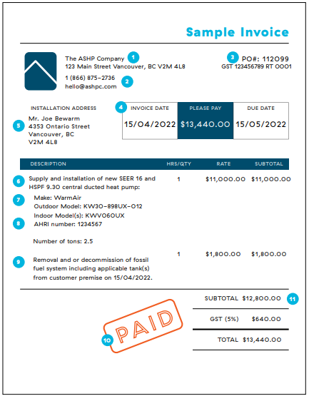
Invoice requirements
By providing the required details on your invoice, it will ensure that your customer’s application is processed without delay.
Please ensure your invoice includes:
Lead installer name
Make & model numbers for all components
AHRI number or copy of AHRI certificate
Capacity of the system (BTU)
Invoice date
Customer name and address
Company legal name, address, phone, email
Company GST number
Confirmation of payment

Slide 22
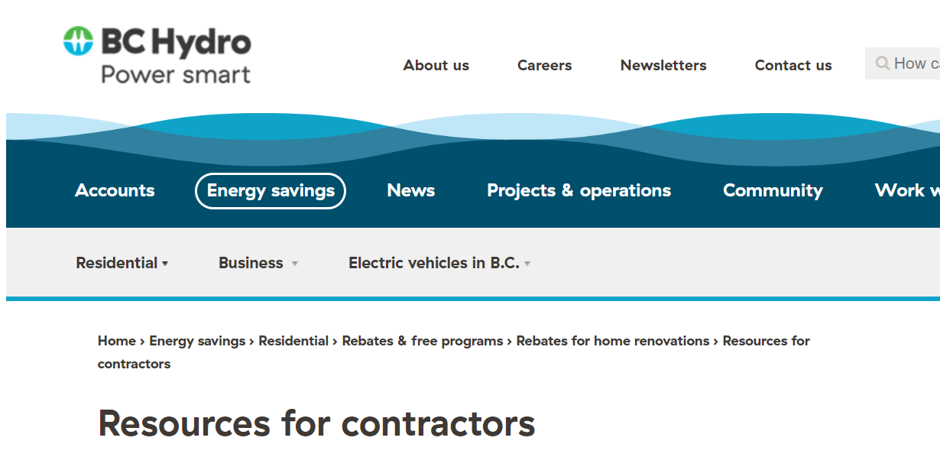
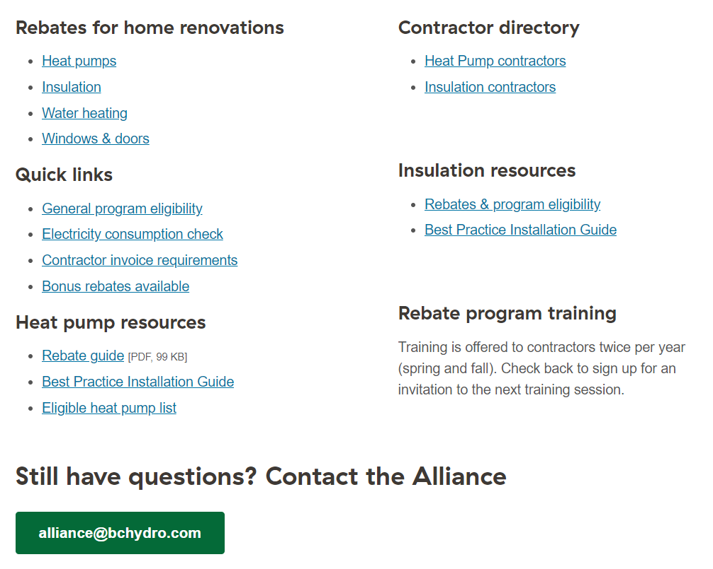
Contractor Support
Quick links for contractor: bchydro.com/contractors
Industry questions: alliance@bchydro.com
Customer website:
bchydro.com/condorebates

Slide 23
CleanBC Energy Savings Program - Condo and Apartment Rebates

Slide 24
CleanBC Energy Savings Program Overview
The CleanBC Better Homes Energy Savings Program (ESP) provides enhanced rebates covering up to 100% of project costs to help make energy-saving upgrades more affordable.
For the Condo and Apartment Rebate, income-qualified applicants will qualify for a rebate level that covers the cost of a heat pump up to a specific amount with a maximum heat pump rebate value of $5,000.
Complement to existing energy efficiency rebate programs offered in British Columbia.
Developed and funded by the Province of British Columbia and BC Hydro; administered in partnership with CLEAResult Canada.
https://betterhomesbc.ca/rebates/condo-and-apartment-rebates

Slide 25
CleanBC Energy Savings Program Goals
Improve energy affordability
  Enable income-qualified households facing financial hardship to achieve higher efficiencies
Increase market awareness
  Enrich residents’ knowledge of energy efficiency and fuel switching opportunities
Reduce Greenhouse Gas Emissions
  Support achieving GHG emission reductions to address climate change

Slide 26
Energy Saving Program General Eligibility Requirements
Participant must meet the program income thresholds.
  Level 1 and level 2 must meet the property value requirement ($772,000)
Home must be one year old, a year-round primary residence, and have a residential account with BC Hydro, FortisBC or municipal utility.
Primary heating: electricity.
Utility accounts must be in the name of the resident and/or homeowner.
Renters must complete the Landlord Consent Form.
Participants in strata or equity co-op buildings must complete the Strata Corporation or Equity Co-op Consent Form.
    Full terms and conditions will be available at https://betterhomesbc.ca/rebates/condo-and-apartment-rebates

Slide 27
Energy Saving Program General Eligibility Requirements Cont'd
Home must be an apartment or suite in a residential building:
  Apartment building up to 6 storeys (market rental and strata condos);
  Stacked townhome building; or
  Multiplex residential units that are individually metered and each have their own exterior entrance with six or more units.
The following types of homes are not eligible for this offer:
  Single-family homes (detached dwelling) and secondary suites in a single-family home (detached dwelling).
  Mobile homes.
  Duplex, triplex, row home or townhomes.
  Long-term care homes.
  Multiplex with up to five units.

Slide 28
Energy Savings Program Income Thresholds

Slide 29
Energy Savings Program Registration Process
Participant must pre-register using the Energy Savings Program participant portal to determine eligibility. Participants are required to submit:
  Income documents from all adults (18yo and older) living in the home.
  Strata or equity co-op consent form, if applicable (ensures strata or equity co-op agree to installation, outdoor unit placement, total scope of work).
  Landlord consent form, if applicable (ensures landlord/building owner agree to installation, outdoor unit placement and total scope of work).
Approved applicants will receive:
  Opportunities report – identifies all eligible upgrades the participant is approved for.
  Eligibility code – identifies their eligibility, income level and is used by the contractor to know how to quote (Level 1 or 2).
New eligibility codes​​
ESPCA1-electric******** = ESP Condo & Apartment Level 1​​
ESPCA2-electric******** = ESP Condo & Apartment Level 2​
​

Slide 30
CleanBC Energy Savings Program Contractor Process
Once an applicant has their eligibility code and opportunity report, ESP registered contractors can supply the participant with a quote.
They have the opportunity to seek additional quotes and choose their contractor.
The contractor may need to supply additional details to ensure the installation meets the strata, landlord or building manager requirements.
The installation can then be completed.
Contractor submits their application using the contractor portal
  If invoice and application includes all necessary details, rebate applications will be processed within two weeks.
  Site verification may happen prior to rebate payment

Slide 31
Energy Savings Program Heat Pump Rebate Overview
Upgrade Type | Rebate Amount
 | Income level 1 | Income level 2
Ductless mini-split heat pump | $5,000 | $4,000
Ductless multi-split heat pump | $5,000 | $4,000

Slide 32
Energy Savings Program Heat Pump Eligibility Requirements
The home must be primarily heated by electricity before the upgrade (e.g. electric baseboards).
The new heat pump must be the primary heating system (a primary heating system must have the capacity to heat a minimum of 50% of the home for the entire heating season to 21°C).
  The existing electric heating system must be disconnected but can be retained for back-up heating and to ensure there is sufficient electrical capacity for the new heat pump.
  Supplemental heating in bedrooms and bathrooms may be retained
The heat pump must serve a main living area of the unit (e.g. family room, living room or open-concept kitchen-living room)

Slide 33
CleanBC Heat Pump Eligibility Requirements Cont'd
The new heat pump must:
Be listed as a qualifying system on the Qualified Heat Pump Product List
Have an AHRI certified reference number that references all components of the heat pump
Meet the product performance ratings:
  HSPF (Region IV) ≥10, SEER ≥16 or,
  HSPF2 (Region IV) ≥ 8.5, SEER2 ≥ 15.2
Have variable speed capacity

Slide 34
CleanBC Heat Pump Eligibility Requirements Cont'd
At the outside winter design temperature, required heating facilities shall be capable of maintaining an indoor air temperature of not less than 22°C in all living spaces, 18°C in unfinished basements, common service rooms, ancillary spaces and exits in houses with a secondary suite, and 15°C in heated crawl spaces.

Slide 35
Energy Savings Program Heat Pump Water Heater Rebate Overview
The existing water heater being replaced must be electric and the primary water heater for the unit.
Emergency replacement of broken electric heat pump water heater or existing electric heat pump water heater is not eligible.
The new heat pump water heater must:
  Be listed as Tier 2, 3 or 4 on NEEA’s Advanced Water Heater Specification Qualified Products List for Heat Pump Water Heaters.
Upgrade Type | Rebate Amount
 | Income level 1 | Income level 2
Heat pump hot water heater | $3,500 | $2,800

Slide 36
Heat Pump and Heat Pump Hot Water Heater Contractor Requirements
Heat pumps and heat pump hot water heaters must be installed by a program registered contractor who is approved to install home upgrades for the CleanBC Energy Savings Program, and for the trade applicable to the upgrade being installed (e.g. Heat pumps must be installed by a licensed residential heating and cooling contractor).

Slide 37
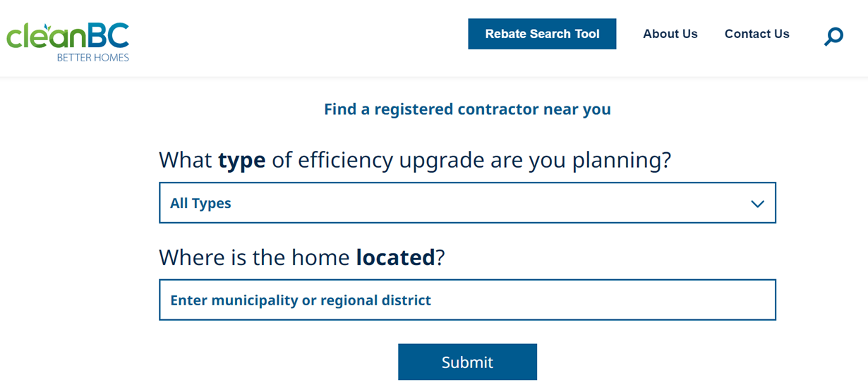
CleanBC Energy Savings Program
Registered Contractors
Participants must use an Energy Savings Program registered contractor for the Condo and Apartment Rebate Program.
HPCN registered contractors will have an opportunity to opt-in to the program and agree to terms and conditions.
Find a Contractor search tool: https://www.betterhomesbc.ca/find-a-contractor/
  Select CleanBC Energy Savings Program Condo and Apartment Rebate

Slide 38
Installation Best Practices
Program requires heat pumps to be installed following the Heat Pump Best Practices Installation Guide for Existing Homes, as applicable.
Must be installed in accordance with the equipment manufacturer's instructions and guidance.
Must be installed in compliance with BC Building Code, municipal and strata bylaws
HPCN Heat Pump Condo and Apartment Installation Guide – Coming Soon
Applications may be sent to site visit before the rebate is processed.
  Collect information regarding the installation
  Check installation against current best practices
  Take photos of the upgrade
  Complete required mitigation within 30 days

Slide 39
Energy Savings Program Invoice Requirements
Heat pump invoices must include:
    Invoice date;
    Contractor name, address, contact and GST number;
    Participant’s name, address and eligibility code;
    Make & model numbers for all components;
    AHRI number or copy of AHRI certificate;
    Capacity of the system (BTU);
    Detailed explanation of the heat pump design and capacity (% square footage of home heated, # head units, type of head unit, # supply outlets, etc);
    Cost; and
    Itemized CleanBC rebate for the Upgrade(s), accurately calculated in accordance with the Participant’s eligibility code and the Program Rebate Requirements and deducted from the Participant’s balance owing to the Registered Contractor on their invoice for the Upgrade(s).
    Sample found at https://www.betterhomesbc.ca/rebates/condo-and-apartment-rebates

Slide 40
Energy Savings Program Contractor Support
Email: ESPCondoApartment@clearesult.com
Phone: 1-833-856-0333
Provincial Program Team: BetterHomesBC@gov.bc.ca

Slide 41
Q&A
Questions
  Type your questions or upvote other questions
  Raise your hand and wait to be unmuted
Comments/discussion
  Use the chat box

Slide 42
Thank you

